Slide 1
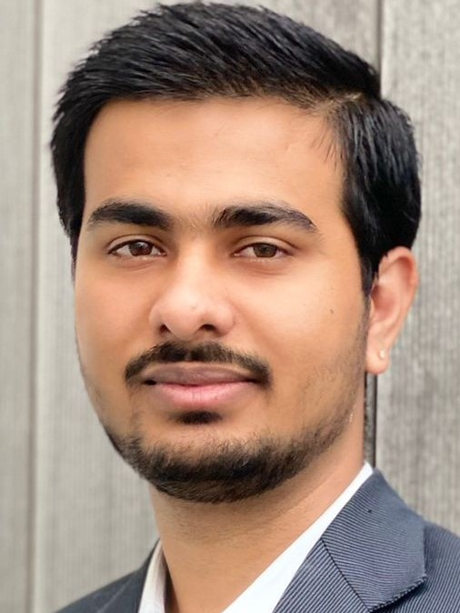
Abhishek Danalakota Technology Consultant
Mobile +353 12211452
Email abhishek.danalakota@ie.ey.com
Background
Professional Experience
System Engineer
Leading Tech Company
February 2018 – January 2019
Abhishek worked as part of IT infrastructure team handled Australian clients and supporting them in maintaining their active directory and information security, providing infrastructural services to clients
He holds a strong knowledge and experience to manage IAM activities including ID administration, provisioning, governance/auditing, reporting, operations.
He also managed user life cycle and integrating application requirements in a shared services framework focused on provisioning, de-provisioning, entitlements and role-based access control
Azure RBAC/ AD - built-in and custom Roles, Security Groups and Scopes.
He was responsible for network monitoring and troubleshooting using appropriate tools
In-depth knowledge on client product and information security best practices
Abhishek has demonstrate strong problem analysis, problem resolution, and decision making and judgment skills
Abhishek demonstrate understanding of complex software architecture, and the ability to help enhance, support, and troubleshoot that architecture.
Abhishek organized the highest levels of systems and infrastructure availability, acting proactively;
Develop, document, and implement CI/CD strategy for management of Infrastructure as Code IaC baseline;
Abhishek is a Technology Consultant within the Digital & Emerging Technology competency of the Technology Consulting division within the EY Irish practice
Prior joining to EY, Abhishek has over 2.5 years of experience as Developer support, Technical support, and application support analyst with comprehensive work experience in the technology service sectors.
He has worked with Fortune 500 companies on their product and service based projects.
Abhishek holds a Master degree in Data Analytics from Dublin Business School and Bachelor of Technology in Computer Science, India where he achieved first class honours
Technology Consultant, EY leading Procurement Company
Abhishek assisted the Project Manager and solutions Architects on technology review engagement.
Created gap analysis chats, strategies and roadmap for the client technology
Associate DevOps Engineer Leading Tech Company
March 2020 – August 2021
Abhishek was responsible for defining and implementing the build, deployment and monitoring standards for this customer.
A part of Agile development teams to deliver an end-to-end automation of deployment, monitoring, and infrastructure management in a cloud environment
Build and configure delivery environments supporting CD/CI tools using an Agile delivery methodology
Create scripts and/or templates to automate and/or bootstrap infrastructure provisioning and management tasks
Abhishek worked closely with the development team to create an automated continuous integration (CI) and continuous delivery (CD) system
Abhishek worked in support of the Senior Information Security Engineer enhancing the security direction for the organization including systems, networks, user services and vendor development efforts.
Abhishek Installed, configured, tested and maintained operating systems, application software and system management tools
Abhishek has experience using Infrastructure as Code tools Terraform, Azure RM, CloudFormation
Skills
Programming Language: Python
CI/CD: Azure DevOps, Git, Policies
Operating System: Windows, Linux - Ubuntu, CentOS, RedHat, Solaris
Web Application & Servers: Apache Tomcat, JBOSS, Ngnix
Networking: LAN, WAN, IP, HTTP, DNS, TCP/IP, UDP, OSI model, Switching and routing
VM’s: Redhat VM, Azure CLI, PowerShell, Java JDK 8/10/11
Terraform Hashicorp certified.
Infrastructure: AKS, Resource Groups, Keyvalut, Log Analytics, Stroage and automation accounts, Function Apps,Data Factory, App Registration and service principles
Microsoft Azure Fundamental Certified
EY Microsoft Azure Learning Badge
ITIL v3 Certified
Lean six sigma trained and tested
Agile SCRUM certified

